Slide 1
Metabolic States and Metabolic Rate
Body Heat and Thermoregulation
Al-Farabi Kazakh National University
Higher School of Medicine

Slide 2
LEARNING OUTCOMES
As a result of the lesson you will be able to:
define the absorptive and postabsorptive states;
explain what happens to carbohydrates, fats, and proteins in each of these states;
describe the hormonal and nervous regulation of each state;
define metabolic rate and basal metabolic rate;
describe some factors that alter the metabolic rate
identify the principal sources of body heat;
describe some factors that cause variations in body temperature;
define and contrast the different forms of heat loss;
describe how the hypothalamus monitors and controls body temperature;
describe conditions in which the body temperature is excessively high or low.
Al-Farabi Kazakh National University
Higher School of Medicine

Slide 3
Introduction
The absorptive (fed) state -
A time in which nutrients are being absorbed and may be stored or used immediately to meet energy and other needs.
The postabsorptive (fasting) state -
During this time, the stomach and small intestine are empty and the body’s energy needs are met from stored fuels.
Al-Farabi Kazakh National University
Higher School of Medicine

Slide 4
The Absorptive State
In the state blood glucose is readily available for ATP synthesis
what things occur in this state with respect to carbohydrate, fat, and protein metabolism?
Al-Farabi Kazakh National University
Higher School of Medicine

Slide 5
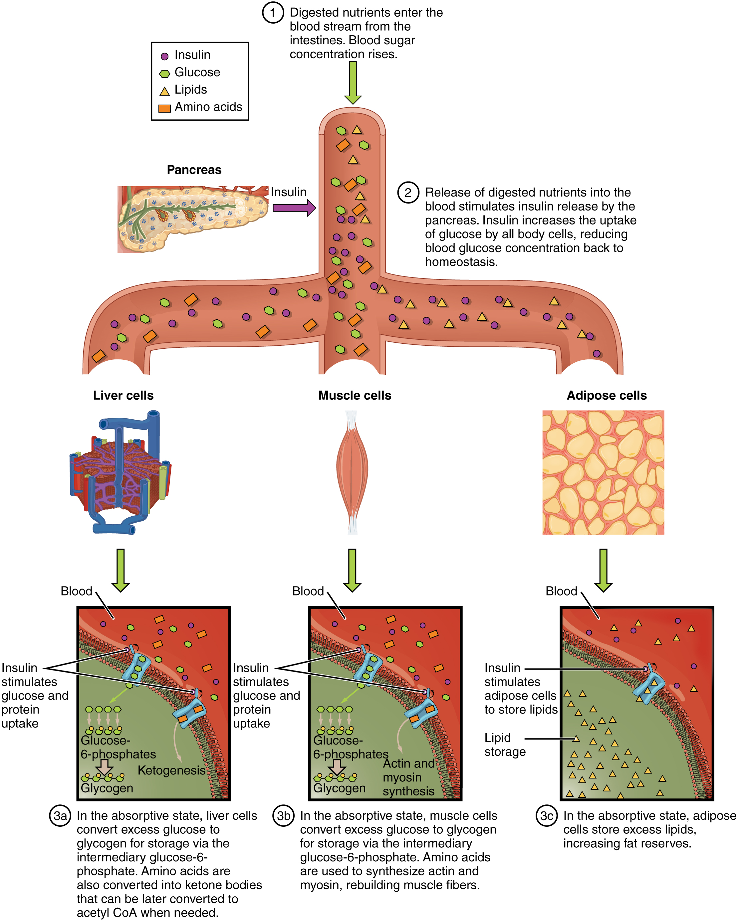
Al-Farabi Kazakh National University
Higher School of Medicine

Slide 6
Regulation of the Absorptive State
insulin
blood glucose and amino acid levels
the intestinal hormones gastrin, secretin, cholecystokinin, and glucose-dependent insulinotropic peptide (GIP)
regulates glucose uptake by nearly all cells (neurons, kidney cells, and erythrocytes)
Glucagon
an insulin antagonist
supports an adequate level of blood glucose to meet the needs of the brain
what is the effects of insulin to target cells ?In type II diabetes, insulin is produced but is nonfunctional. These patients are described as “starving in a sea of plenty,” because their blood glucose levels are high, but none of the glucose is transported into the cells. Describe how this leads to malnutrition
Al-Farabi Kazakh National University
Higher School of Medicine

Slide 7
The Postabsorptive State
Homeostatically regulate plasma glucose concentration within about 90 to 100 mg/dL.
Critical to the brain
what things occur in this state with respect to carbohydrate, fat, and protein metabolism?
Al-Farabi Kazakh National University
Higher School of Medicine

Slide 8
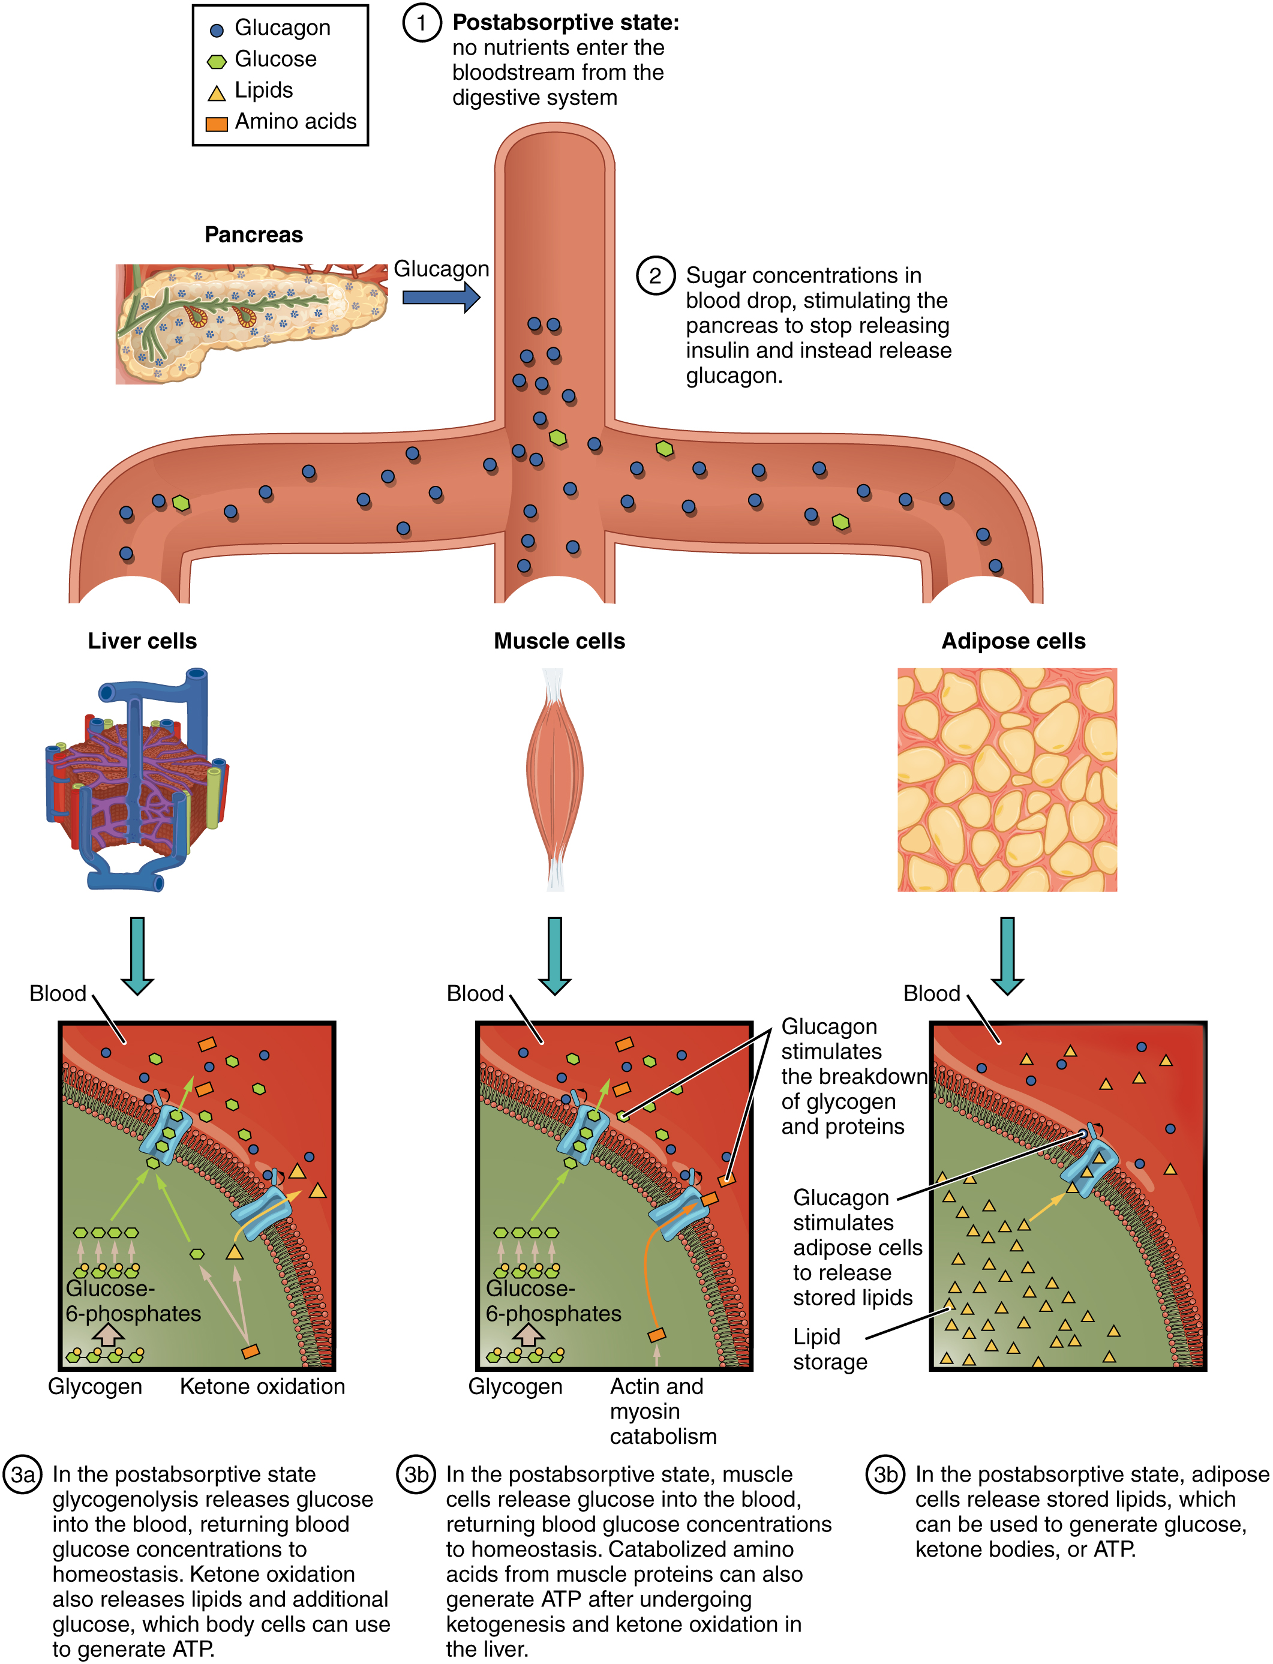
Al-Farabi Kazakh National University
Higher School of Medicine

Slide 9
Regulation of the Postabsorptive State
sympathetic nervous system
glucagon
blood glucose levels drop, insulin secretion declines,the pancreatic alpha cells secrete glucagon
promotes glycogenolysis and gluconeogenesis
promotes lipolysis and rise in FFA levels
makes both glucose and lipid available for fuel
The sympathoadrenal system also promotes glycogenolysis and lipolysis
Growth hormone response to a rapid drop in blood glucose level and in states of prolonged fasting
Al-Farabi Kazakh National University
Higher School of Medicine

Slide 10
Metabolic Rate
The amount of energy liberated in the body per unit of time, expressed in such terms as kcal/h or kcal/day.
calorimeter
spirometer
Metabolic rate depends on physical activity, mental state, absorptive or postabsorptive status, thyroid hormone and other hormones, and other factors
basal metabolic rate (BMR)
Total metabolic rate (TMR)
what is the difference between BMR and TMR?
Al-Farabi Kazakh National University
Higher School of Medicine

Slide 11
Al-Farabi Kazakh National University
Higher School of Medicine

Slide 12
Part I – Hypoglycemia
A 50-year old Asian woman was found breathing but unresponsive in her home. According to family members who called emergency services, she had been drinking alcohol continuously for two days. The patient had a history of chronic alcoholism and hepatitis-C. A fingerstick glucose test done by the paramedic returned a value of < 20 mg/dL, indicating severe hypoglycemia.
As a team, come up with hypotheses about what caused the hypoglycemia. Be prepared to share your team’s hypoth- eses with the class, along with your rationale for your hypotheses.
The questions below are designed to guide you in developing your hypotheses. You may need to seek additional resources to explore the questions below. Some reliable online resources for medical tests and conditions include
WebMD.com, CDC.gov, and MayoClinic.org.
Al-Farabi Kazakh National University
Higher School of Medicine

Slide 13
What metabolic mechanisms are normally at work to keep blood glucose levels within the normal range?
What conditions in the patient may have altered her normal glucose metabolism?
Al-Farabi Kazakh National University
Higher School of Medicine

Slide 14
Body Heat and Thermoregulation
Why maintain stable body temperature is important to human?
Al-Farabi Kazakh National University
Higher School of Medicine

Slide 15
Body Temperature
Core temperature -
the temperature of organs in the cranial, thoracic, and abdominal cavities.
Shell temperature -
the temperature closer to the surface, especially skin and oral temperature.
Shell temperature fluctuates as a result of processes that serve to maintain a stable core temperature
Al-Farabi Kazakh National University
Higher School of Medicine

Slide 16
Thermoregulation
thermoregulation is achieved through several negative feedback loops
hypothalamic thermostat
monitors temperature of the blood
receives signals from peripheral thermoreceptors in the skin
send appropriate signals to either the heat-loss center – a nucleus in the anterior hypothalamus
or the heat-promoting center in a more posterior nucleus near the mammillary bodies of the brain
Al-Farabi Kazakh National University
Higher School of Medicine

Slide 17
Thermoregulation
blood temperature is too high
cutaneous vasodilation
blood temperature is too low
cutaneous vasoconstriction
shivering thermogenesis
nonshivering thermogenesis
behavioral thermoregulation
Al-Farabi Kazakh National University
Higher School of Medicine

Slide 18
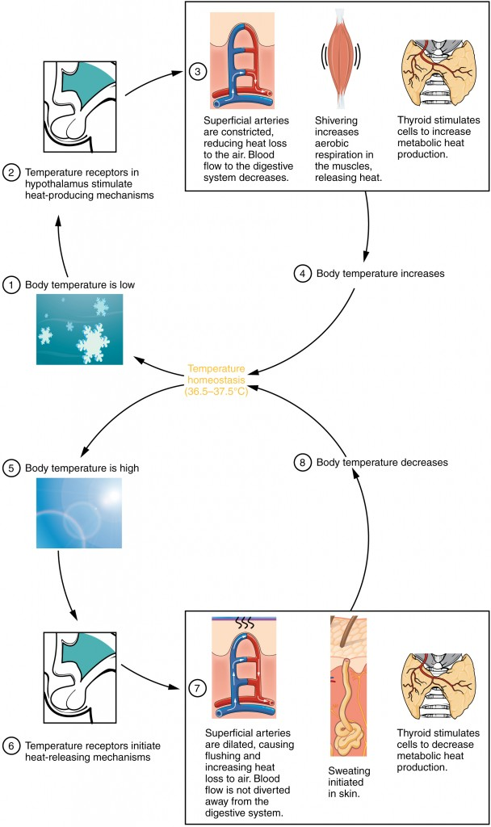
Al-Farabi Kazakh National University
Higher School of Medicine

Slide 19
Reference:
Saladin, Anatomy & Physiology, McGraw Hill, New York,2018
National center for case study teaching in science. https://sciencecases.lib.buffalo.edu/

